Slide 1
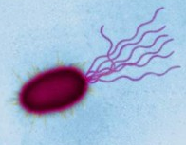
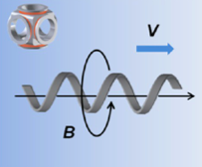
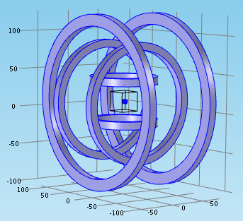
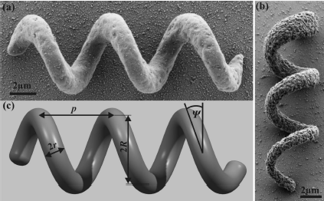
Platform for Microrobot Navigation
Nafiseh Vahabi
MRes

Slide 2
History of Swimming Microrobot
At 1930 (Bruce) first swimming mechanism at micro scale
Bell 2007 first Artificial Bacteria Flagellum
Zhang 2009, characterized them
Mahoney et al. 2012, velocity control
Nelson et al. 2013, actuation and fabrication

Slide 3
Potential Application
application divided into two categories:
Biomedical In vivo
Minimally invasive procedures
Targeted drag delivery
Ablation of the material
Delivery of hyperthermia for cancer treatment
In vitro (lab-on-a-chip)
Manipulation and characterization of cells
Microfluidic control
Most of these applications placed micro-device into fluidic or soft environment.

Slide 4
Challenges
Design
Locomotion mechanism
Control mechanism
Actuation method
Fabrication

Slide 5
Project Overview
Simulation
Propulsion Algorithm
Actuation Algorithm
Design
Optimization
Validation
Fabrication
Nanoscribe
SEM

Slide 6
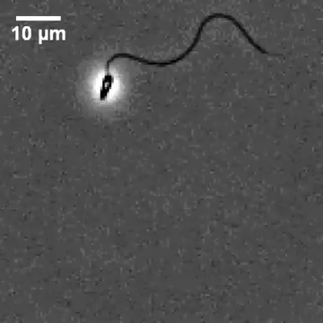
Design

Slide 7
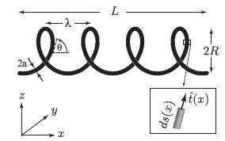
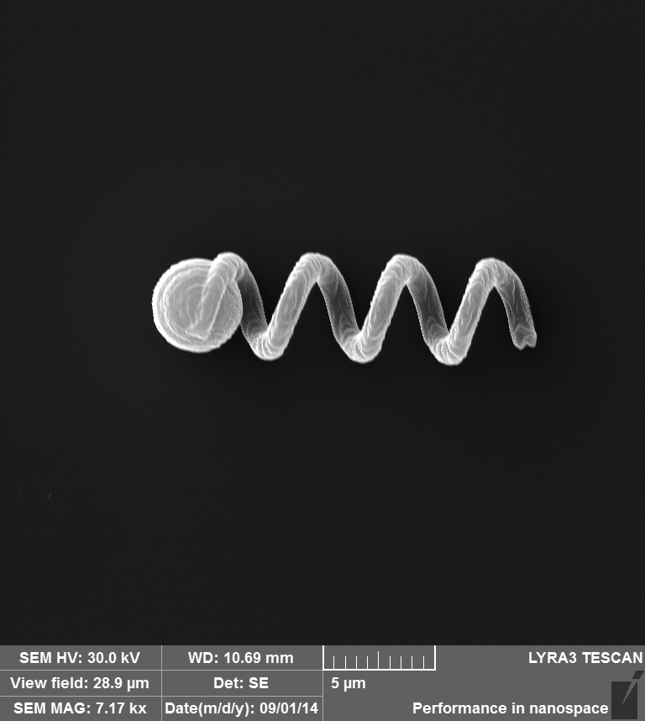
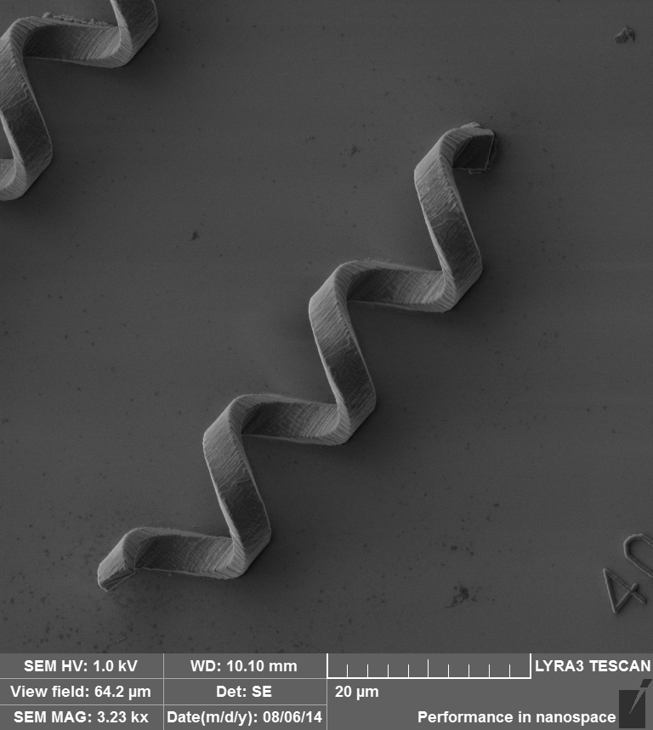
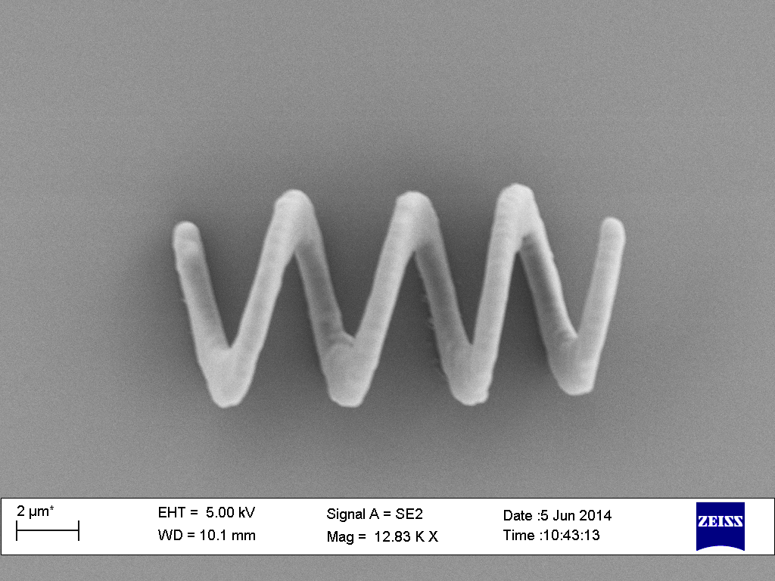
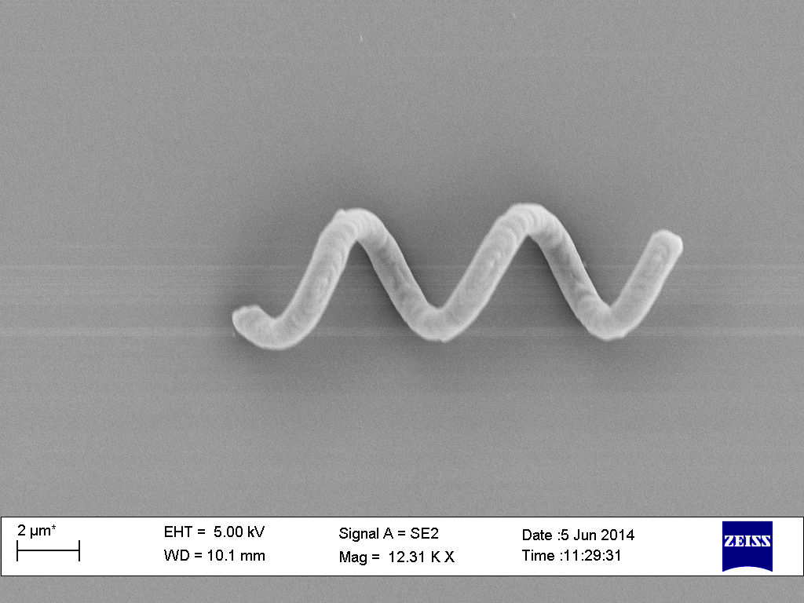
Design
Helix key parameters
Helix length
Pitch
Pitch angle
Helix radius
Filament radius

Slide 8
Simulation
Desired
Velocity
Propulsion
Algorithm
Actuation
Algorithm
Electric
Current
Magnetic
Field
Torque

Slide 9
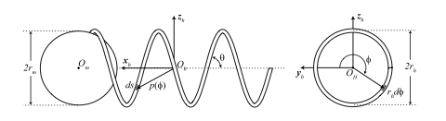
Propulsion Method
Resistive Force Theory (RFT)
Decomposes the velocity vector
9

Slide 10
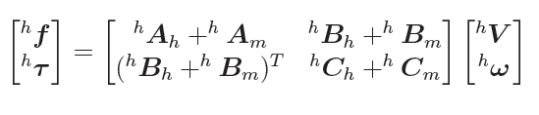
Resistive Force Theory
Propulsion matrix

Slide 11
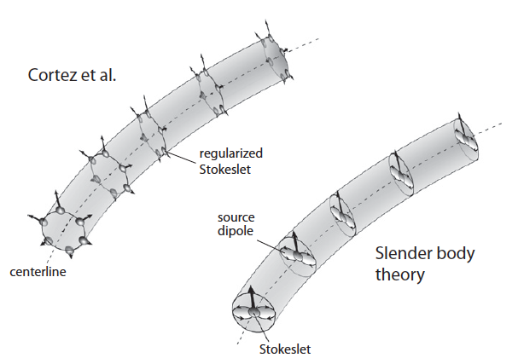
Propulsion Methods
Regular Stokeslet Methods (RSM)
Discritzed helix with the cross sections
Body Slender Theory (BST)
Based on central helix axis

Slide 12
Actuation
Force driven
Torque driven
Gravity compensation

Slide 13
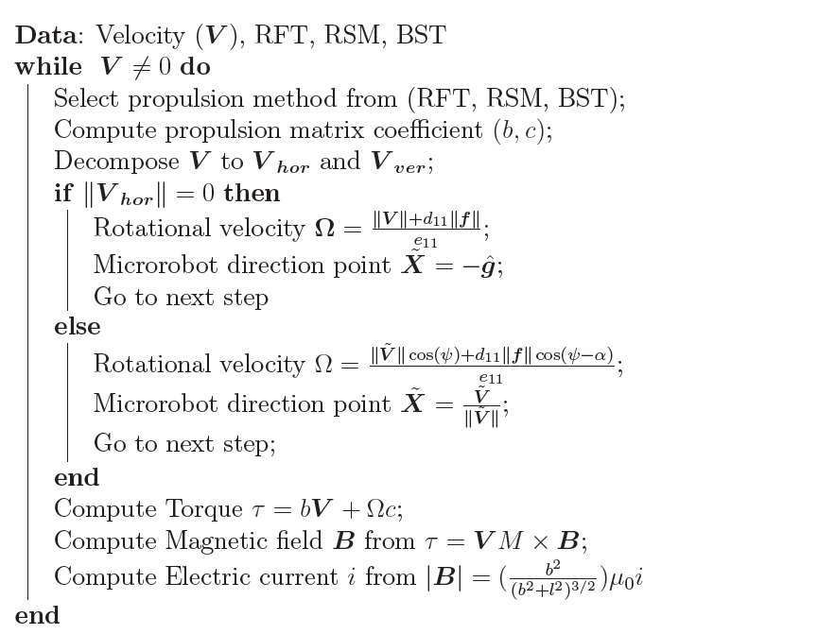
Simulation Algorithm

Slide 14
Fabrication
Nanoscribe
Preparing
Production
SEM
Post-processing
Sputter Coating
Image Analysis
Coating
Magnetic
Material

Slide 15
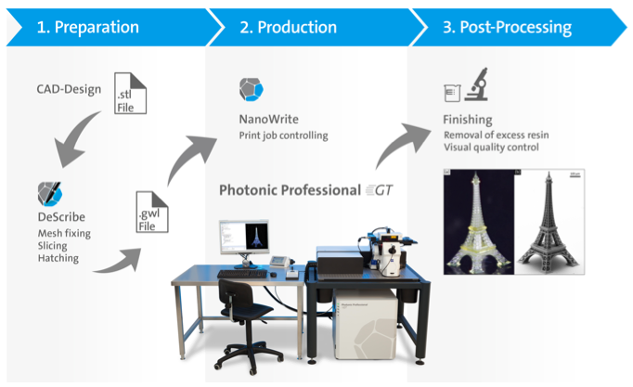
Nanoscribe

Slide 16
Nanoscribe
Advanced device for Nano-scale 3D printer
Based on laser lithography and two polymerization technique
Two writing mode:
High-speed galvo-mode
Moving-Beam Fixed-Sample
Ultra-precise piezo-mode
Fixed-Sample Moving-Beam
Using photosensitive material

Slide 17
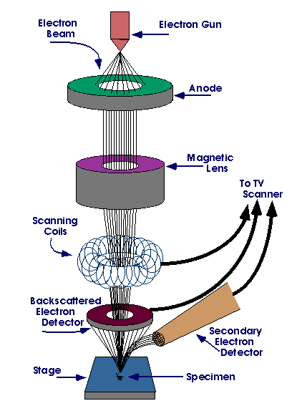
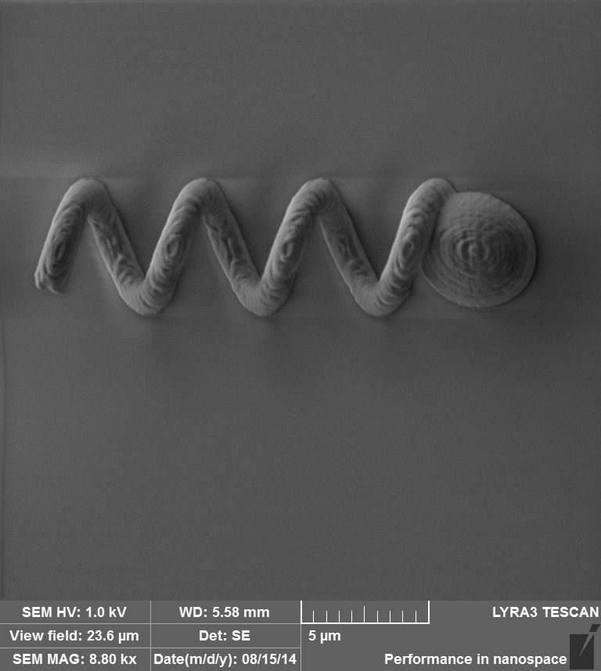
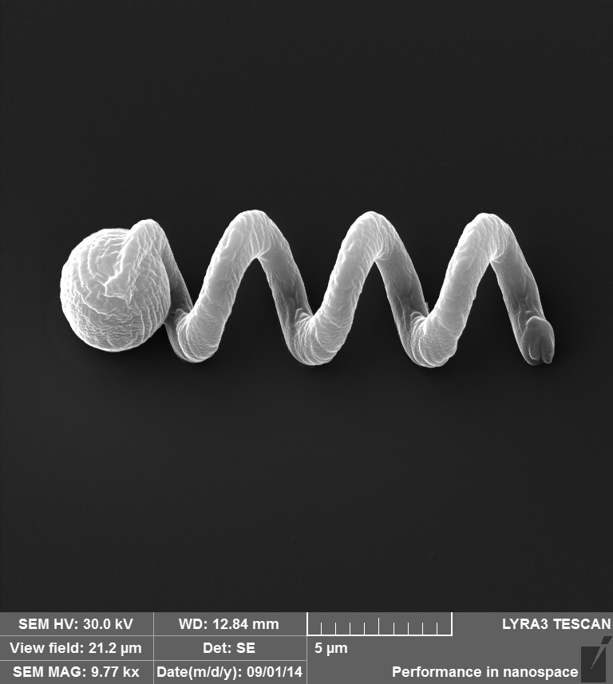
Scanning Electron Microscope
Sputter Coating

Slide 18
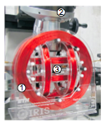
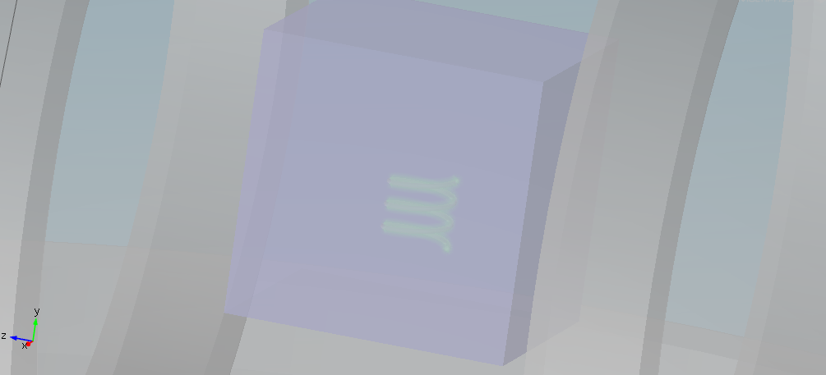
Simulation Result

Slide 19
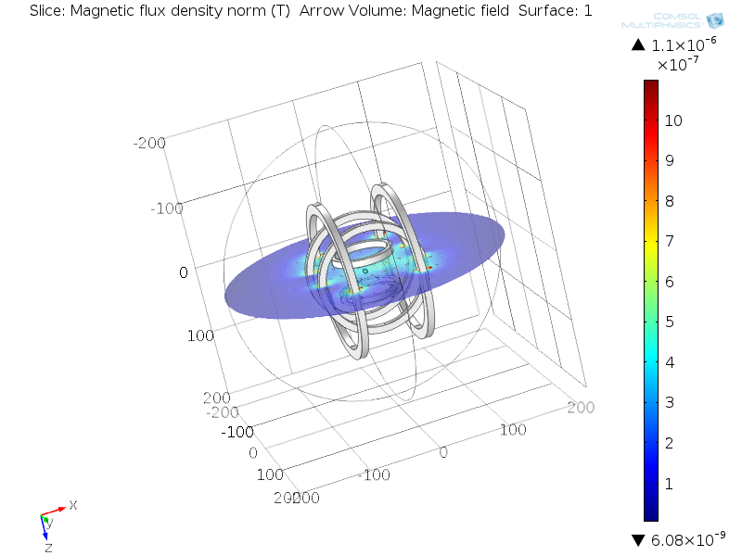
Simulation Result

Slide 20
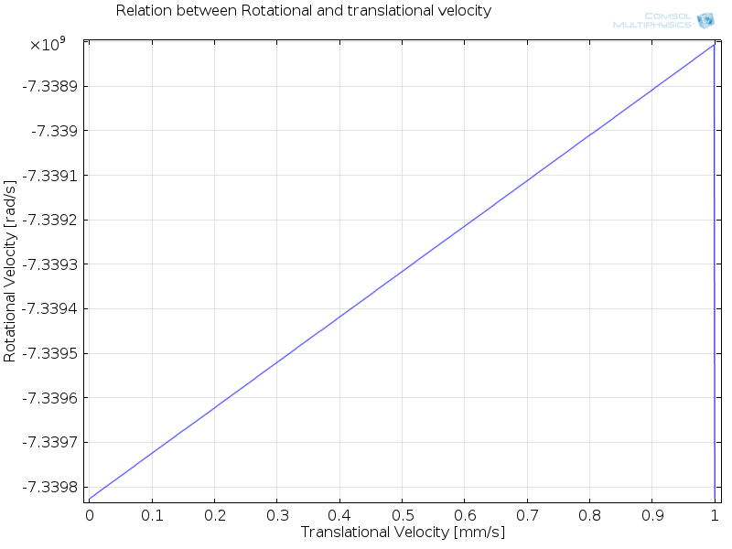
Simulation Result

Slide 21
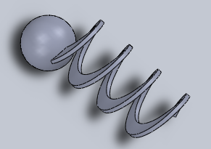
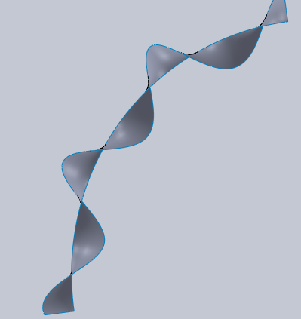
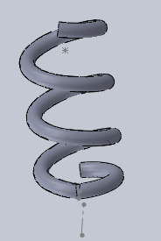
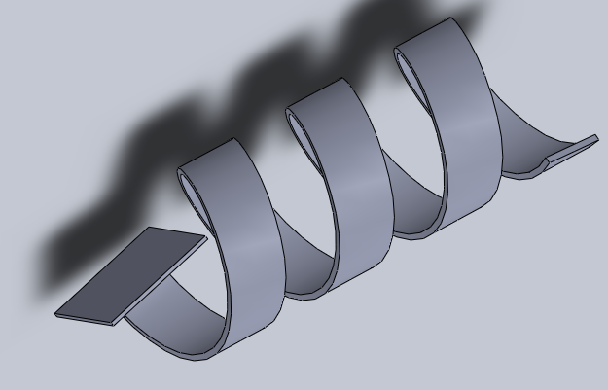
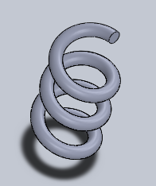
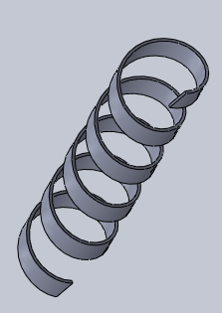
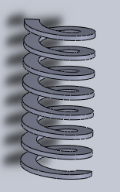
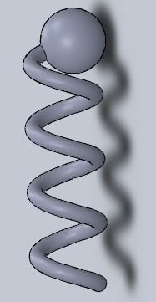
Design Results
- Helix with the variable pitch
- Capable to add propellers

Slide 22
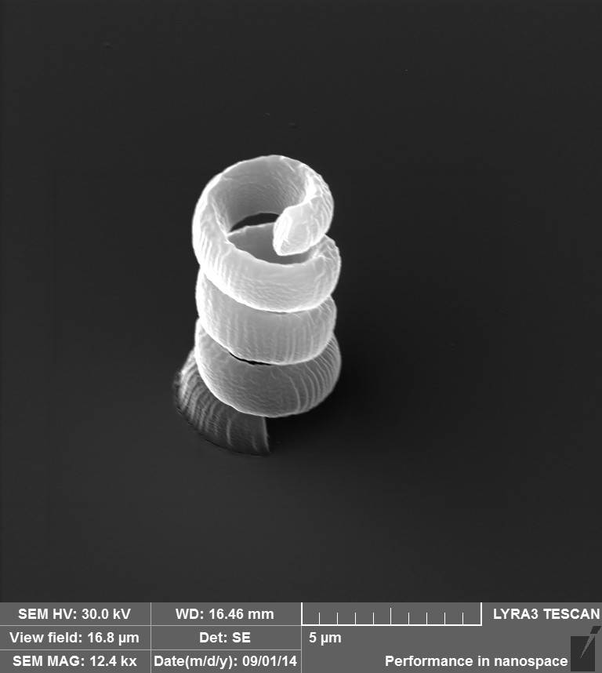
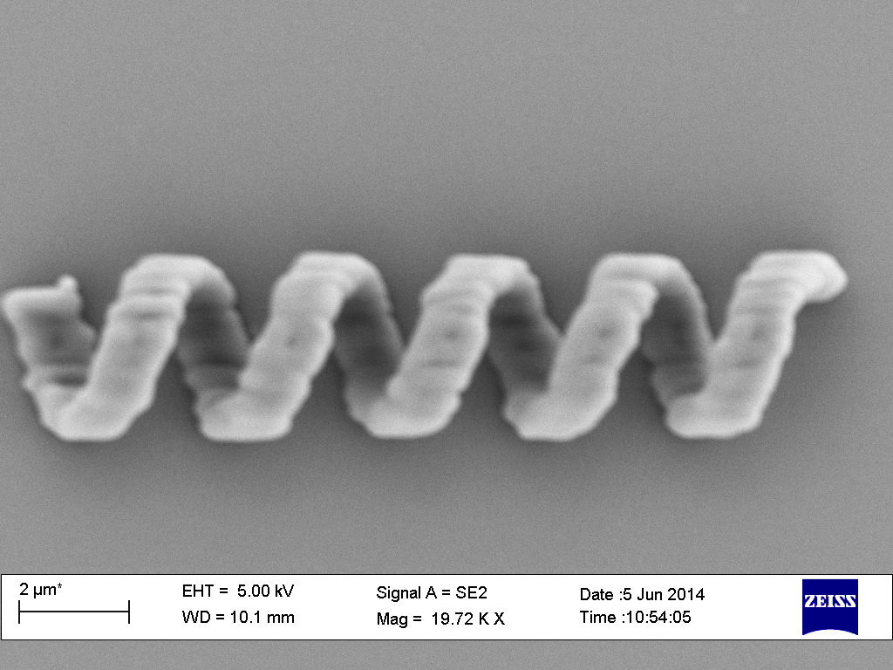
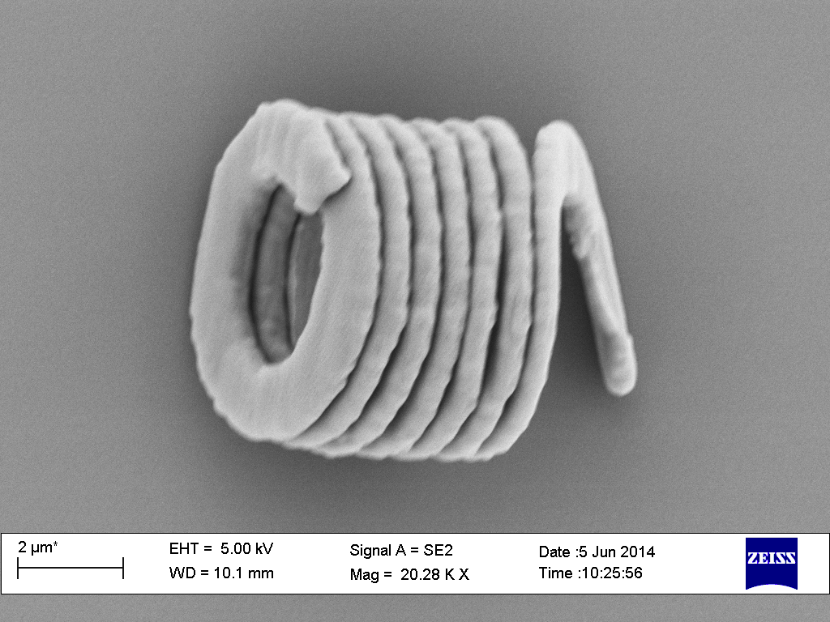
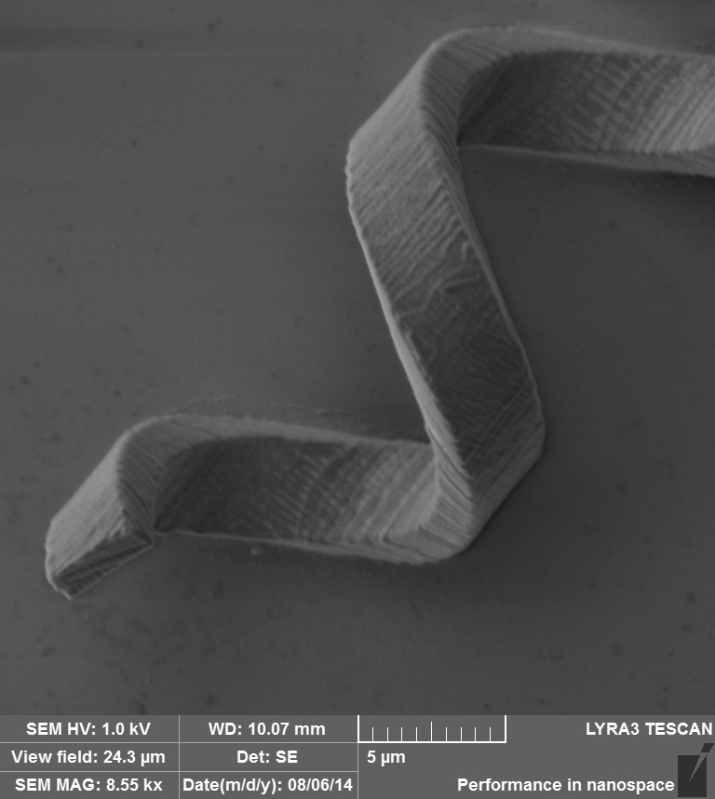
Fabrication Result
Helix can stand vertically

Slide 23
Conclusion
Mathematics model to find electric current from microrobot velocity is solved
New design of microrobot to satisfy fabrication requirement
Helix propulsion methods for remotely controlled microrobot
Basic framework for microrobot simulation
Future work
Optimizing simulation platform
Applying new actuation method such as ultrasonic
Designing propeller with the helix tail

Slide 24
Thank you for your attention Thanks to my supervisors Prof. Guang-Zhong Yang Dr. Vincenzo Curto Dr. Henry Ip

